Slide 1

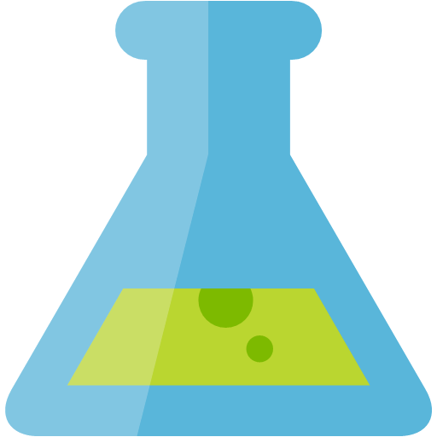



Lab Architecture – June 2020
MODEL TRAINING
MODEL MANAGEMENT
AUTO ML
Track Runs & Register Models
Azure Machine Learning Workspace
Register Automated Machine Learning Model
Azure Machine Learning Compute
Azure Databricks (PyTorch & Keras)
INGEST
LONG TERM STORAGE
STREAM DATA PROCESSING
Retrieve Model
IoT Hub or Event Hubs
Azure Storage
Battery Telemetry
Azure Databricks (Spark Structured Streaming)
Simulated Data Stream
(NOTE: not used in the lab)
(NOTE: a CSV file of previously captured streaming data is provided to expedite setup)
BATCH DATA PROCESSING
Component Text
Azure Databricks (Spark DataFrames)

Slide 2


Preferred Solution – September 2020
DATA PREPARATION
MODEL TRAINING
MODEL MANAGEMENT
AUTO ML
Track Runs & Register Models
Azure Machine Learning Workspace
Register Automated Machine Learning Model
Azure Machine Learning Compute
Azure Databricks
Data Cleansing and Preparation
Model Training (PyTorch & Keras)
Deploy models
REAL-TIME INFERENCING
INGEST
LONG TERM STORAGE
Azure
Kubernetes
Service
Historical data
Retrieve Model
(NOTE: AKS is the production-grade choice for deploying models used in real-time inferencing. To expedite setup time and optimize costs, the lab is using ACI - Azure Container Instances - for model deployment, which is only recommended for dev/test scenarios.)
STREAM DATA PROCESSING
IoT Hub
Batch write messages to storage endpoint
Azure Blob Storage
Battery Telemetry
Simulated Data Stream
(NOTE: not used in the lab)
(NOTE: a CSV file of previously captured streaming data is provided to expedite setup)
Azure Databricks (Spark Structured Streaming)
BATCH DATA PROCESSING
Component Text
Azure Databricks (Spark DataFrames)

